Slide 1
Digital Portfolio
STUDENT NAME: Harisudhan.A
REGISTER NO AND NMID: 24134060500121020 and asanm40624134060500121020
DEPARTMENT: BCA
COLLEGE: COLLEGE/ UNIVERSITY:Dharmapuram Adhinam Arts College,Affiliated Annamalai University

Slide 2
PROJECT TITLE
*Creative Student Portfolio Using FWD

Slide 3


AGENDA
Problem Statement
Project Overview
End Users
Tools and Technologies
Portfolio design and Layout
Features and Functionality
Results and Screenshots
Conclusion
Github Link
3/21/2024 Annual Review

Slide 4

PROBLEM STATEMENT A digital portfolio provides an interactive and accessible platform to perform to perform achievements, skills and experiences

Slide 5

PROJECT OVERVIEW The aims to empower students and young leaders with the skills, knowledge and confidence to become innovation problem-solves and change-makers.The project focuses on developing leadership qualities, fostering creativity and promoting social responsibility

Slide 6

WHO ARE THE END USERS? *Students(projects, resumes) *Job seekers(career counseling) *young professionals(leadership skills)

Slide 7

TOOLS AND TECHNIQUES #HTML-->Structure . #Css-->Styling . #JS-->Interactivity

Slide 8
POTFOLIO DESIGN AND LAYOUT
*Home/About Me
*project
*skills
*contact
*Responsive layout
8

Slide 9
FEATURES AND FUNCTIONALITY *Navigation bar-with smooth scrolling *proje ct showcase with image/ details *contact form(validation) *Responsive design for all devices

Slide 10
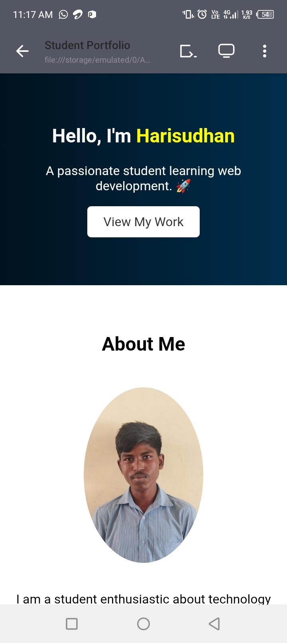

RESULTS AND SCREENSHOTS
3/21/2024 Annual Review
10

Slide 11
CONCLUSION The project has been a resounding success, empowering students and young leaders with the, knowledge and confidence to become innovation problem -solvers and change makers.
11

